Slide 1
RxJS
Combining Streams
Lecture 6
By James(Jin) Wang
12/05/2021

Slide 2
Outline
Combination operators
Combining streams to map an id to a string

Slide 3
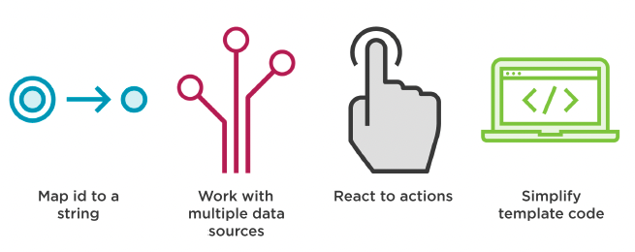
Combination operators
  Why Combine Observable Streams?

Slide 4

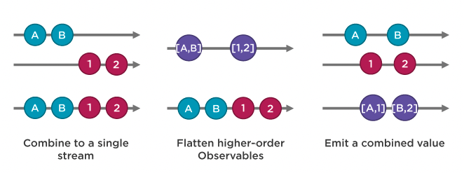
Combination operators
  Combination Operators/Functions
  Types of Combination Operators/Functions

Slide 5
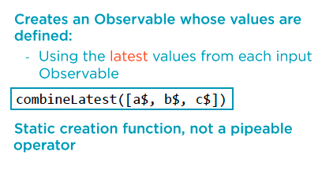
Combination operators
  RxJS Creation Function: combineLatest

Slide 6
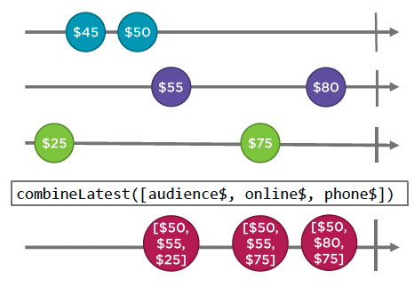
Combination operators
  Marble Diagram: combineLatest

Slide 7
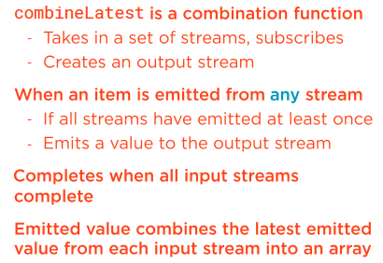
Combination operators
  RxJS Creation Function: combineLatest

Slide 8
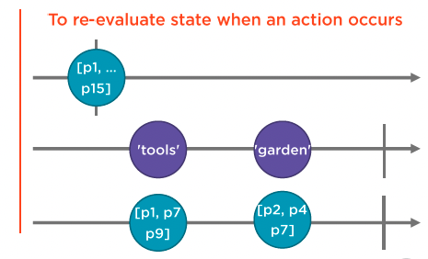
Combination operators
  Use combineLatest

Slide 9
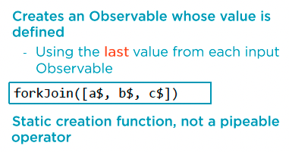
Combination operators
  RxJS Creation Function: forkJoin

Slide 10
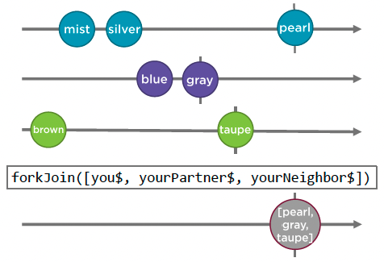
Combination operators
  Marble Diagram: forkJoin

Slide 11
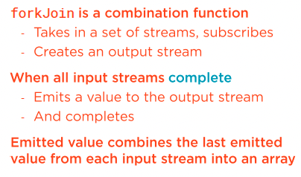
Combination operators
  RxJS Function: forkJoin

Slide 12
Summary

Slide 13
Assignment

Slide 14
Self Study
  RxJS: The Big Picture
  https://app.pluralsight.com/library/courses/rxjs-big-picture

